Slide 1
Sealing Devices & The Importance of PFAS
CONFERENCE
ORGANIZERS

Slide 2
Sealing Devices and the Importance of PFAS
Phil Mahoney | Fluid Sealing Association | Fluid Sealing Association Government Affairs Committe Chair

Slide 3
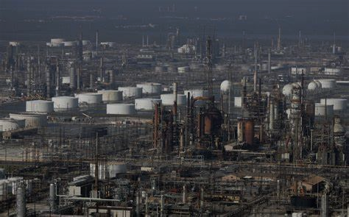

Introduction to the Fluid Sealing Association
Member Companies FSA website - accessed March 24, 2024 | Mechanical Seals | Pump & Valve Packings | Gaskets | Expansion Joints
A.R. Thomson Group | X | X | X | X
A.W. Chesterton Co | X | X | X
John Crane Inc | X | X | X
EGC Enterprises, Inc |  | X | X
Empak Spirotallic Mexicana SA de CV |  | X | X
Garlock Sealing Technologies |  | X |  | X
SEPCO - Sealing Equipment Products Co. | X | X
W. L. Gore & Associates, Inc. |  | X | X
American Braiding & Mfg. |  | X
Cori Engineers Private Limited |  |  |  | X
Dinatecnica Ind. e Com. |  |  |  | X
Durlon Sealing Solutions |  |  | X
Flextech Industries Ltd. |  |  |  | X
Flowserve - Flow Solutions Group | X
General Rubber LLC |  |  |  | X
Industrias Vago de Mexico SA de CV | X
Juntas Flex Seal SRL |  |  | X
Kadant Unaflex LLC |  |  |  | X
KLINGER Thermoseal |  |  | X
Lenzing Plastics GmbH & Co KG |  | X
Lien Foo (Dongtai) Rubber & Metal Products Co. |  |  |  | X
Metallized Carbon Corporation | X
Morgan Advanced Materials | X
New England Braiding Co. Inc. |  | X
Proco Products, Inc |  |  |  | X
Pt. Sabi Tehnik |  |  |  | X
SPE (Scenic Precise Element) | X
Teadit North America |  | X
The Metraflex Co |  |  |  | X
Thermodyn Corp |  |  |  | X
Thorburn Flex, Inc |  |  |  | X
UIP International |  |  |  | X
US Graphite Corporation | X
VSP Technologies |  |  | X
Founded in 1933
Membership: Majority of sealing device manufacturers in North America
Education
  Training
  Technical Articles
  Government Affairs
Technical Resources
  Knowledge Base
  Standards
Alignment with other Trade Associations
Page 2

Slide 4
Key Points to Address
Not all PFAS materials are the same
  Legislative & Regulatory focus should be on Non-Polymeric Chemicals of Concern
Fluoropolymers are essential to the Sealing industry
  Unmatched range of properties compared to other sealing materials
  There are no replacement for fluoropolymers & elastomers at this time.
Need a Science Based Approach
  Potentially hazardous materials should be addressed
  Need standardized test for detecting PFAS in products

Slide 5
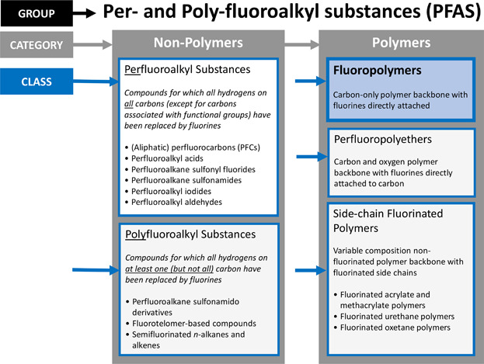
PFAS - What are they?
PFAS = (Per and Poly Fluoroalkyl Substances)
Definition varies depending on region
  U.S. Federal / State, EU, etc.
  Most common: ‘at least one fully fluorinated carbon atom’
# of applicable chemicals - 4.7k to 10k+
  Approx. 10% are produced commercially
Fluoropolymers (PTFE) and Fluoroelastomers fall under this umbrella (blue box upper right)
  Are considered PLCs – “Polymers of Low Concern”
  Products made of polymers are safe
Hazards of all PFAS are not clearly defined
Page 3

Slide 6
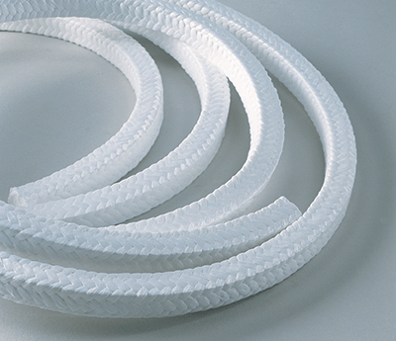
What Makes Fluoropolymers Unique?
Unmatched Resistance to Oxidation
Impervious to attack from most chemicals
Stable at high temperatures
Very Low Coefficient of Friction
Excellent Sealability
High Durability
Very Stable
Don’t degrade over time to base materials
Page 6
Notes:
Do Fluoroelastomers have the same benefits as Fluoropolymers? Yes

Slide 7
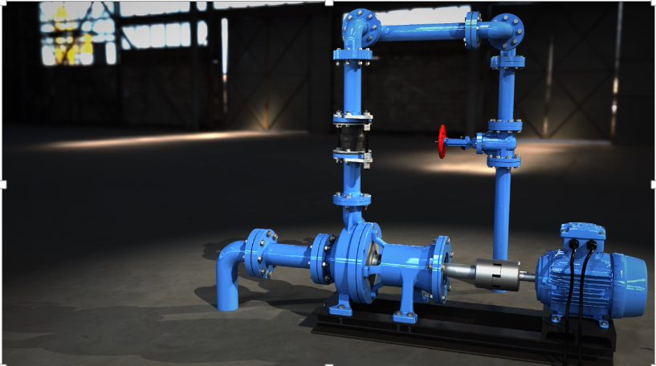
What is a Sealing Device?
A device used to contain a fluid within a system.
Used between static or dynamic elements
  Mechanical Seals
    Used in Pumps, Agitators, Mixers, etc.
  Compression Packing
    Used in Valves and Pumps
  Gaskets
    Pipe Flanges, Valve Bonnets, Heat Exchangers
  Expansion Joints
    Piping systems
  Hydraulic / Pneumatic Seals (not shown)
    Actuators, Cylinders
Page 7
Notes:
Devices that prevent leaks from both dynamic and static equipment components
Everywhere there is a pump, agitator, mixer, valve, pipe run etc.
Media of all types:
Aggressive chemicals
Abrasive media
Toxic or Hazardous materials
Gases/liquids/ solids
Conditions across a range from Extreme heat or cold, full vacuum to extreme pressures
Note also other types of sealing devices not covered by FSA, i.e. O-ring manufacturers, Hydraulic/ Pneumatic Seals, oil seals etc.

Slide 8
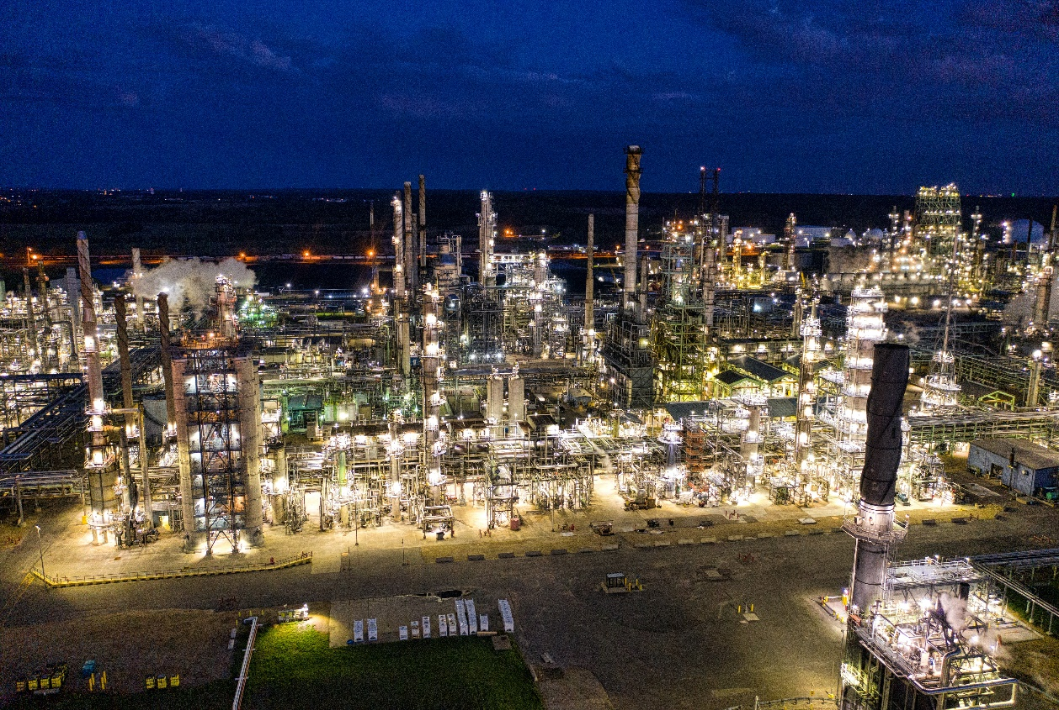
Sealing Devices are Ubiquitous to Industry
Power Generation (Fossil, Nuclear, Renewable)
Water / Wastewater
Oil & Gas (Fugitive Emissions)
Chemical Processing
Mining / Ore Processing
Pulp & Paper
Pharmaceutical
Aerospace
Semi-conductor
Military / Defense
HVAC & Refrigeration
… And Pretty Much Everywhere Else…
Page 8
Notes:
R=Refrigeration

Slide 9
Sealing Devices - Market Size & Channels
Global Market- ~$30B Annually
Sealing Devices are consumable & eventually Wear Out
Channels
  Original Equipment Manufacturers (OEM)
  Maintenance and Repair Operation - Maintenance Cycles
    Re-builds
    Replacement
Page 9

Slide 10

Sealing Devices - Market Drivers
Reliability / Efficiency
  Maintenance run times constantly being extended
  Efficiency (Energy / Leakage)
  Decreased staffing available
  Inventory costs
Safety
  Long term, consistent performance
  Poka-Yoke selection process
  Increasing application parameters (temp / press)
Sustainability
  Growing corporate focus on sustainability --> voluntary, market-led response
Page 10
Notes:
What is “Poka-Yoke”? – a checklist or process that helps prevents errors or defects.

Slide 11
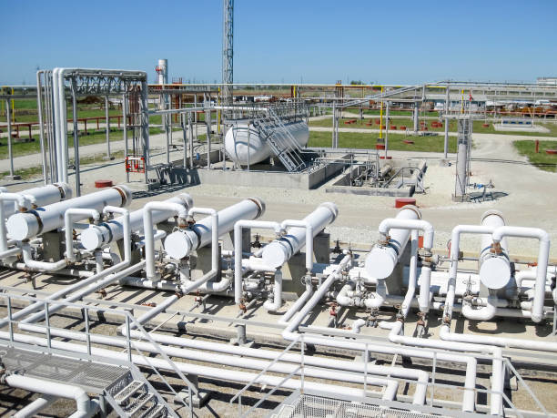
Sealing Devices - Developing Markets
Hydrogen
  New range of applications
  Difficult to seal; dangerous media
EVs - Mineral production (for batteries)
  Increase in demand will drive:
    Demand for new equipment
    Longer MTBR (mean time between repair) requirements
  Dangerous medias (acid, heavy)
Biofuels
  Fluoroelastomers challenged, but fluoropolymers work well.
Page 11

Slide 12
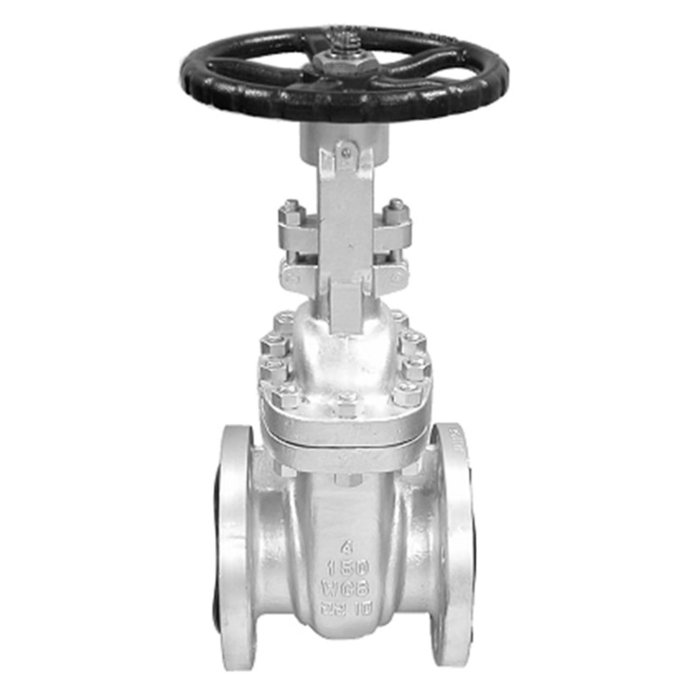
Sealing Devices - Importance of Fluoropolymers
Refineries: Low Fugitive Emission Requirements (Valves)
EPA Clean Air Act (CAA) requirement is <500ppm VOC
Consent Decree requirement for Enhanced LDAR is typically < 100ppm VOC
  Several CDs have requirement < 50ppm VOC
API Valve & Packing standards - Revised for low VOC leak requirements
Current Low Emissions Seals (<100ppm)
Pure PTFE - up to 400°F
Graphite / PTFE - up to 600+°F
Pure graphite packings can not meet these requirements
Alternate Solutions
Bellows valves
  More costly, especially sizes above 2”
  Footprint: requires greater space than packed valve
  Failure modes: may require redundant seals
Magnetic Drive Valves
  Smaller footprint
  More costly
Page 12
Notes:
Which states are regulating VOCs to 50 ppm?

Slide 13


Importance of Fluoropolymers - Reliability
Improved Reliability Needed
Increasingly difficult requirements
  Extended Application parameters (Temp, Fluid)
  Extended Mean Time Between Repair (MTBR)
  Costs to repair
Requires high performance materials like Fluoropolymers (PTFE)
Page 15

Slide 14
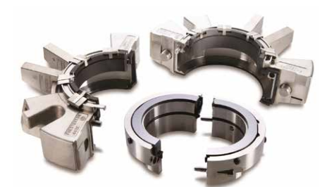
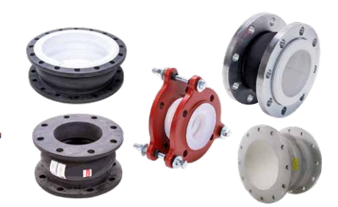
Importance of Fluoropolymers & Fluoroelastomers
Improved Safety
Proper material selection is extremely important
  O-ring selection for mechanical seals
  Expansion Joints
  Gaskets
Alternate technologies may present greater risk or cost
  Metal vs. fluoropolymer lined expansion joint
  Flanges (w/ fluoropolymer gaskets) vs. Welded pipe
Page 13

Slide 15
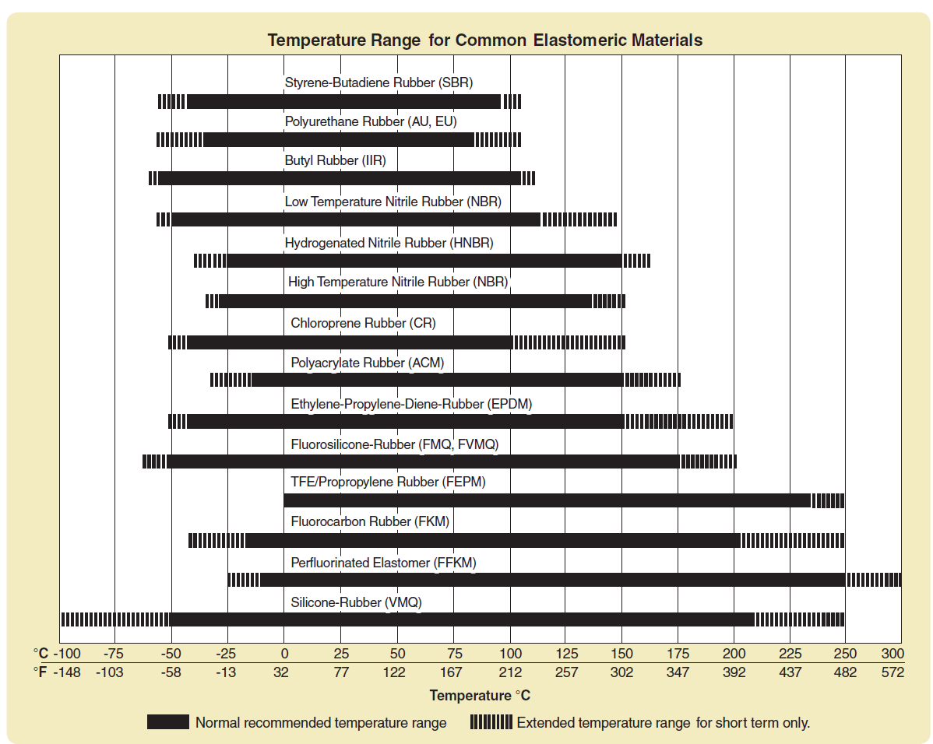
Importance of Fluoroelastomers - Temperature
Fluoroelastomers
Wider temp range
Higher temp capability
Solid line – continuous use
Dash line – short term use
Images courtesy of Parker O-Ring Handbook (ORD 5700), www.parker.com/literature/O-Ring Division
Page 14
Notes:
What are the key points for fluoroelastomers and temperature?
300F is red line –
Solid line – continuous use
Dashed line – excursion use
All Fluoroelastomers can work wider temperature range
Silicone is not an equivalent use
Mechanical seals require fluoroelastomers - ubiquitous

Slide 16
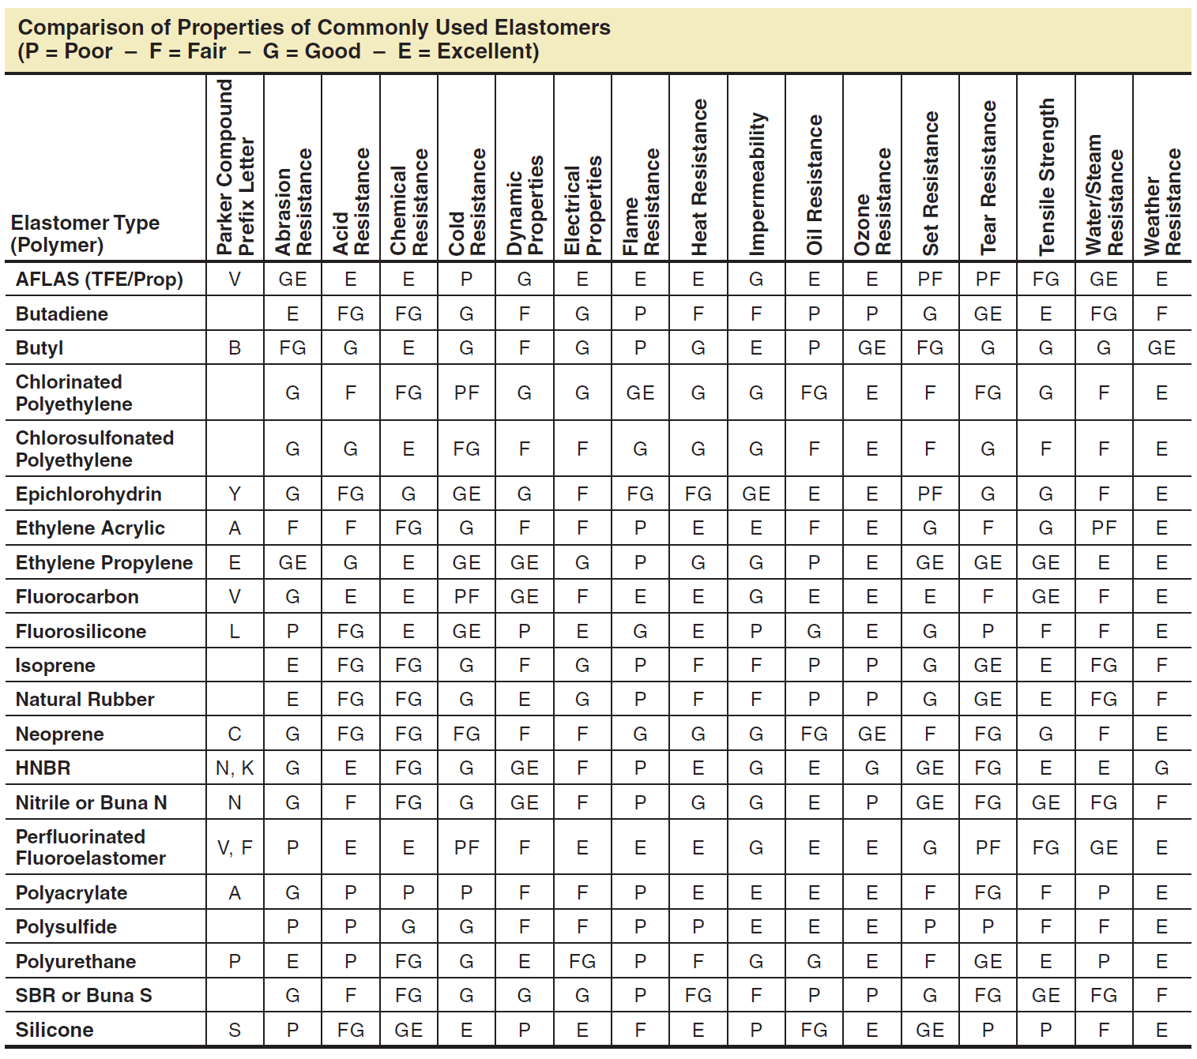
Importance of Fluoroelastomers – Key Properties
Fluoroelastomers
Have Excellent resistance to:
Acids
Chemicals
Heat
Oils
Blue rows - Fluoroelastomers
Images courtesy of Parker O-Ring Handbook (ORD 5700), www.parker.com/literature/O-Ring Division
Page 14
Notes:
Blue rows are fluoroelastomers – are excellent for the 4 columns
Silicone is not similar to fluoroelastomers – can not handle the same ranges

Slide 17
What’s Driving Concerns with PFAS?
Increasing concerns about health effects of certain PFAS chemicals
  They break down very slowly hence the common term: ‘Forever Chemicals’.
  Have been found in drinking water, soil and living organisms
Many Current Legislative / Regulatory activities label all PFAS as hazardous when some are not hazardous.
  Non-polymeric PFAS - PFOA & PFOS - are largely legacy chemicals that are of primary concern
    PFOA was used years ago to aid the production of PTFE.
      Major manufacturers voluntarily moved away from it years ago as part of a program driven by US EPA
    PFOS was used in stain resistant fabric coating products and in fire-fighting foam (AFFF)
  These 2 chemicals have been identified as potentially hazardous to human health
Page 4
Notes:
Should this presentation briefly explain (1 slide) how PFAS chemicals got into water, soil and people? - No

Slide 18
What’s Happening Out There? U.S. Federal Level
Legislative:
Senators Carper & Capito - PFAS Action Act (EPW Committee)
Consistent and Practical Definition of PFAS for federal agencies, state governments and other entities
Help bolster understanding of beneficial and nonessential uses of PFAS in Commerce
Direct EPA to create a clearinghouse of state and private sector best practices to support informed decision-making on these chemicals; and,
Direct EPA to work with an external standards-setting organization to supplement the agency’s work on PFAS standards—including for detection, reduction, destruction, remediation, and verification
NDAA (National Defense Authorization Act) - Annual Military budget
PFAS product requirements regularly included
U.S. Dept of Defense- Report on Critical Per- and Polyfluoroalkyl Substance Uses
  “If future PFAS legal and regulatory frameworks … seek to broadly restrict the use of PFAS based on chemical structure, there could be extensive economic, industrial competitiveness, and quality-of-life impacts to society.”
  “Congress and the Federal regulatory agencies should avoid taking a broad, purely “structural” approach to restricting or banning PFAS.”
  “It is critical that future laws and regulations consider and balance the range of environmental and health risks associated with different individual PFAS, their essentiality to the U.S. economy and society, and the availability of viable alternatives.”
EPA:
PFAS Roadmap
CERCLA
RCRA- Hazardous substance designation for PFAS
EPA TSCA Section 8(a)(7) Reporting and Recordkeeping requirements for PFAS- released 10/11/23
  Requires 1 time report on all PFAS utilized dating back to 2011
Page 5
Notes:
EPA is taking a measured and science based approach –
EPA activities:
TSCA – inventory the use of PFAS

Slide 19
What’s Happening Out There? U.S. State Level
Various States implementing or proposing legislation to:
  Require reporting on products containing PFAS coming into the State
  Ban PFAS in specific consumer goods
  Ban All PFAS
Currently 54 Active PFAS related Bills in 17 states
  Lead States: Maine & Minnesota
Of Note
  Definition of PFAS varies widely:
    Any substance with a “fully fluorinated carbon atom”
    …”a non-polymeric perfluoroalkyl substance:…”
  Maine has requested proposals for ‘Currently Unavoidable Uses’ (CUU)
    Define specific PFAS, its use, and available alternatives
      Drafting similar proposal in Minnesota
Notes:
Parse out non-essential uses. If it’s not CUU then it could be parsed out.

Slide 20
What’s Happening Out There? International Level
Europe
European Chemical Assn (ECHA) – In 2023, Proposed Ban on all PFAS
5,600 comments from 552 Associations, 30 countries and 61 NGO’s
70% of the responses focused on fluoropolymers/ fluoroelastomers
European Sealing Assn (ESA) submitted Socioeconomic Analysis:
  “Businesses surveyed…would be able to substitute around 20% of the products…affected by the restriction”.
No standardized analytical method to measure levels of all PFAS.
    Not being considered as part of ECHA proposal.
Canada
Regulation in place to prohibit manufacture, use, sale and import of PFOA, PFOS and long chain perfluorocarboxylic acids
Per- and Polyfluoroalkyl Substances (PFAS Report) in DRAFT
Notes:
What is ECHA? European Chemical Agency – EU EPA?
Focusing on End of Life Studies – currently being performed; do the FP breakdown at end of life? Not made of PFOA, it won’t breakdown to PFOA

Slide 21
Key Points and Current FSA Activities
Key Points to Remember
  FSA Talking Points
    Not all PFAS chemicals are the same
      Focus should be on Non-Polymer PFAS with known health concerns
    Fluoropolymers are essential to the sealing industry
      There are no replacement materials at this time with similar capability, effectiveness and cost
    Science Based Approach is Needed
      No standardized tests for PFAS in products
FSA Current activities
  Joining Coalitions: American Chemistry Council, U.S. Chamber, etc.
  Government Affairs- Federal and State
  Presentations at appropriate Conferences
  Alignment with related Trade Associations
Page 16

Slide 22
Fluid Sealing Association & Other Useful Links
Web: Fluid Sealing Association – Founded in 1933
LinkedIn: Fluid Sealing Association | LinkedIn
Facebook: Fluid Sealing Association | Wayne PA | Facebook
Web: European Sealing Association
  EU PFAS restriction – Plastics Europe (fluoropolymers.eu)
Contact: Government Affairs PFAS Task Force Chair
Phil.Mahoney@Chesterton.com
www.fluidsealing.com
Page 17

Slide 23
Fluid Sealing Association & Other Useful Links
Web: Fluid Sealing Association – Founded in 1933
LinkedIn: Fluid Sealing Association | LinkedIn
Facebook: Fluid Sealing Association | Wayne PA | Facebook
Web: European Sealing Association
  EU PFAS restriction – Plastics Europe (fluoropolymers.eu)
Contact: Government Affairs PFAS Task Force Chair
Phil.Mahoney@Chesterton.com
www.fluidsealing.com
Page 17

Slide 24
Thanks
ORGANIZING SECRETARIAT
Ph. +39 035 3230904
e-mail info@industrialvalvesummit.com
CONFERENCE ORGANIZERS
Ph. +39 3474908420
e-mail segreteria@valvecampus.com
www.industrialvalvesummit.com
www.valvecampus.com

